Slide 1
Activity Diagrams
Emphasizes Flow of control from Activity to Activity

Slide 2
Definition
Activity diagrams represent the dynamics of the system.
They are flow charts that are used to show the workflow of a system.
They show.
  The flow of control from activity to activity in the system,
  What activities can be done in parallel.
  Alternate paths through the flow.
They can show the flow across use cases or within a use case.

Slide 3
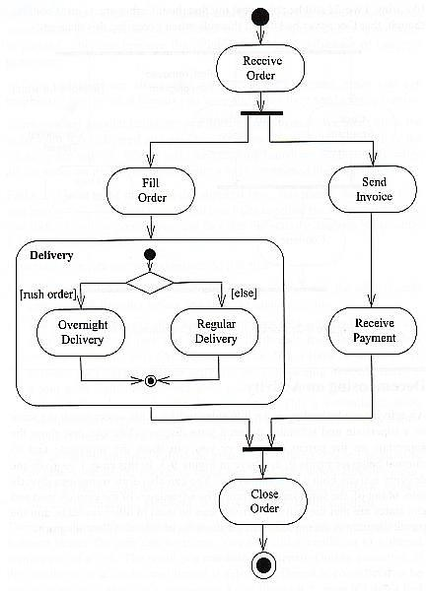

Slide 4
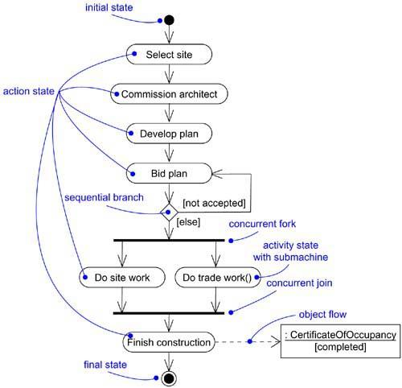

Slide 5
Common Properties
Collection of Vertices and Arcs
Contents:
  Activity states and Action States
  Transitions
  Objects

Slide 6
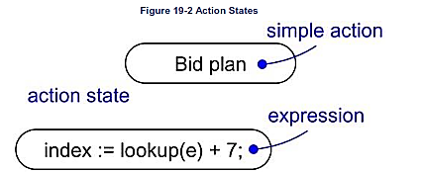
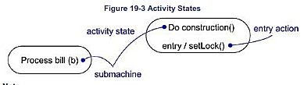
Action States and Activity State
Activity State
Action State
Can be decomposed
Their Activity can ne represented by other activity diagram
An action state is an activity state that cannot be further decomposed.
Activity state is a composite of activity states and action states.
Executable Atomic computation is called action state
Can’t be decomposed
Atomic in nature
Generally takes insignificant execution time.

Slide 7
Other contents
Transitions
Branching
Forking and Joining
Swimlanes
Object Flow

Slide 8
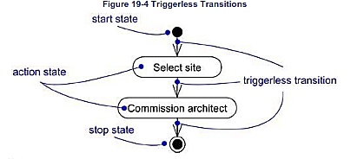
Transistion
When the action or activity of a state completes, flow of control passes immediately to the next action or activity state.
You specify this flow by using transitions to show the path from one action or activity state to the next action or activity state

Slide 9
Branching
Simple, sequential transitions are common, but they aren't the only kind of path you'll need to model a flow of control.
As in a flowchart, you can include a branch, which specifies alternate paths taken based on some Boolean expression.
A branch may have one incoming transition and two or more outgoing ones.
On each outgoing transition, you place a Boolean expression, which is evaluated only once on entering the branch.
Across all these outgoing transitions, guards should not overlap (otherwise, the flow of control would be ambiguous), but they should cover all possibilities (otherwise, the flow of control would freeze).

Slide 10
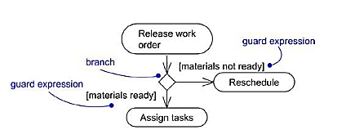

Slide 11
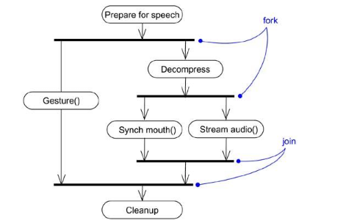
Forking and Joining
We might encounter flows that are concurrent. In the UML, you use a synchronization bar to specify the forking and joining of these parallel flows of control.
A synchronization bar is rendered as a thick horizontal or vertical line.

Slide 12
Swimlanes
When we are modeling workflows of business processes, to partition the activity states on an activity diagram into groups, each group representing the business organization responsible for those activities.
In the UML, each group is called a swimlane because, visually, each group is divided from its neighbor by a vertical solid line.
A swimlane specifies a locus of activities.
Each swimlane has a name unique within its diagram. A swimlane really has no deep semantics, except that it may represent some real-world entity.
Each swimlane represents a high-level responsibility for part of the overall activity of an activity diagram, and each swimlane may
Each swimlane has a name unique within its diagram. A swimlane really has no deep semantics, except that it may represent some real-world entity.

Slide 13
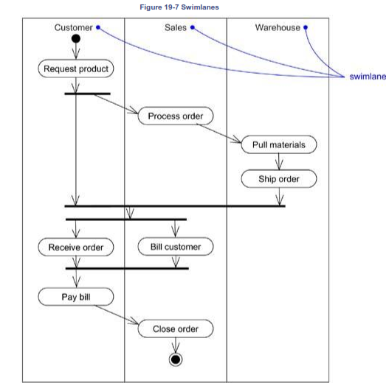

Slide 14
Object Flow
Objects are involved in the flow of control.
While showing the flow of an object through an activity diagram, we can also show how its role, state and attribute values change.
State of an object is shown by naming its state in brackets below the object name. Also value of the object attribute can be represented in compartment below object’s name.

Slide 15
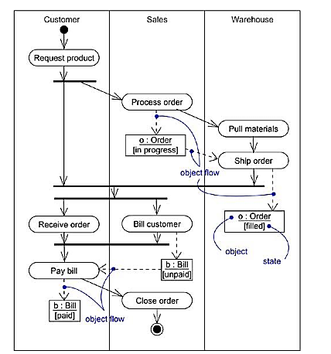

Slide 16
Common uses
Use activity diagram in the context of the system as a whole, a subsystem, an operation, or a class.
Can attach activity diagrams to Use cases(To model scenario) and to collaborations( To model dynamic aspects of a society of object)
Common Modeling Techniques
  To model a workflow
  To model an operation

Slide 17
To Model a Workflow
Establish a focus for the workflow.(For nontrivial systems not possible to show whole workflow in a single diagram)
Select business objects that have high- level responsibilities. Create swimlanes for each.
Identify pre and post conditions of the workflow.
Specify activities and actions that take place over the time.
For complicated actions/ set of actions collapse them in to activity state.
Render transitions and branching.
If there are any important objects, involve them in the workflow and show there change values

Slide 18
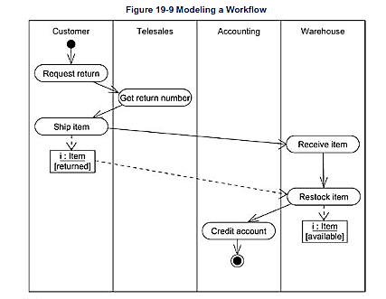

Slide 19
To Model an operation
Collect the abstractions that are involved in this operation including its return type.
Identify Preconditions at the operations initial state and post condition at final state.
Specify activities and actions over time
Use branching and transitions.
If operation is owned by an active class, use forking and joining as necessary to specify parallel flow of control.

Slide 20
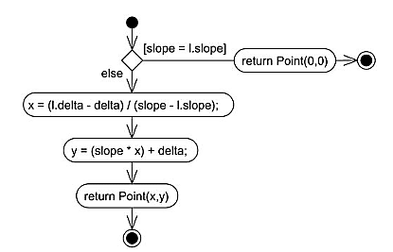

Slide 21
Forward and Reverse Engineering
Forward engineering (the creation of code from a model) is possible for activity diagrams, especially if the context of the diagram is an operation.
For example, using the previous activity diagram, a forward engineering tool could generate the following C++ code for the operation intersection.
  Point Line::intersection (l : Line)
  {
  if (slope == l.slope) return Point(0,0);
  int x = (l.delta - delta) / (slope - l.slope);
  int y = (slope * x) + delta;
  return Point(x, y);
  }

Slide 22
Reverse engineering (the creation of a model from code) is also possible for activity diagrams, especially if the context of the code is the body of an operation.
In particular, the previous diagram could have been generated from the implementation of the class Line.

Slide 23
Drawback
Activity diagrams tell you what is happening, but not who does what.
In domain modeling, this diagram type does not convey which people or departments are responsible for each activity.
In programming, it does not convey which class is responsible for each activity.

Slide 24
When to use Activity Diagrams
Do use them for
  Analysing Use Cases.
  Understanding workflow across many Use Cases.
  Dealing with multi-threaded applications.
Don’t use them
  to see how objects collaborate.
  to see how an object behaves over its lifetime.

Slide 25
Activity Diagram for Receiving an Order
Receive
order
* for each line
item on order
Authorise
Payment
Check line
item
[failed]
[in stock]
Cancel
Order
[succeeded]
Assign
to Order
[need to reorder]
Reorder
item
[stock assigned
to all line items
and payment
authorised]
Dispatch
Order

Slide 26
Activity Diagram for receiving Supply
Receive
Supply
Choose outstanding
order items
* for each chosen order item
Assign goods
to order
[all outstanding order items filled]
Add remainder
to stock
Dispatch
Order

Slide 27
Combined Activity Diagram
Receive
order
Receive
Supply
* for each line
item on order
Choose
outstanding
order items
Check line
item
Authorise
Payment
[failed]
[in stock]
* for each chosen order item
[succeeded]
Assign
to Order
Assign goods
to order
Cancel
Order
[need to reorder]
Reorder
item
[stock assigned
to all line items
and payment
authorised]
[all outstanding order items filled]
Dispatch
Order
Add remainder
to stock

Slide 28
With Swimlanes
Finance
Order
Processing
Stock
Manager
Receive
order
Receive
Supply
* for each line
item on order
Choose
outstanding
order items
Check line
item
Authorise
Payment
[failed]
[in stock]
* for each chosen order item
[succeeded]
Assign
to Order
Assign goods
to order
Cancel
Order
[need to reorder]
Reorder
item
[stock assigned
to all line items
and payment
authorised]
[all outstanding order items filled]
Dispatch
Order
Add remainder
to stock

